Slide 1



Computer vision introduction with OpenCV
Guillaume Chervet
TechLead – ML Engineer

Slide 2


Introduction à la
« Computer Vision »
avec OpenCV
Guillaume Chervet
TechLead – ML Engineer - @guiChervet

Slide 3
Conclusion

Slide 4
Devoxx France 2023
Introduction à la
« Computer Vision »
avec OpenCV
Guillaume Chervet TechLead – ML Engineer
@guiChervet

Slide 5
Devoxx France 2023
Conclusion

Slide 6


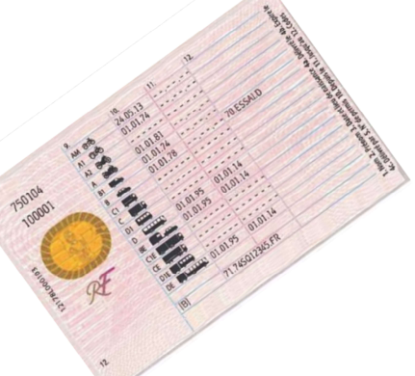


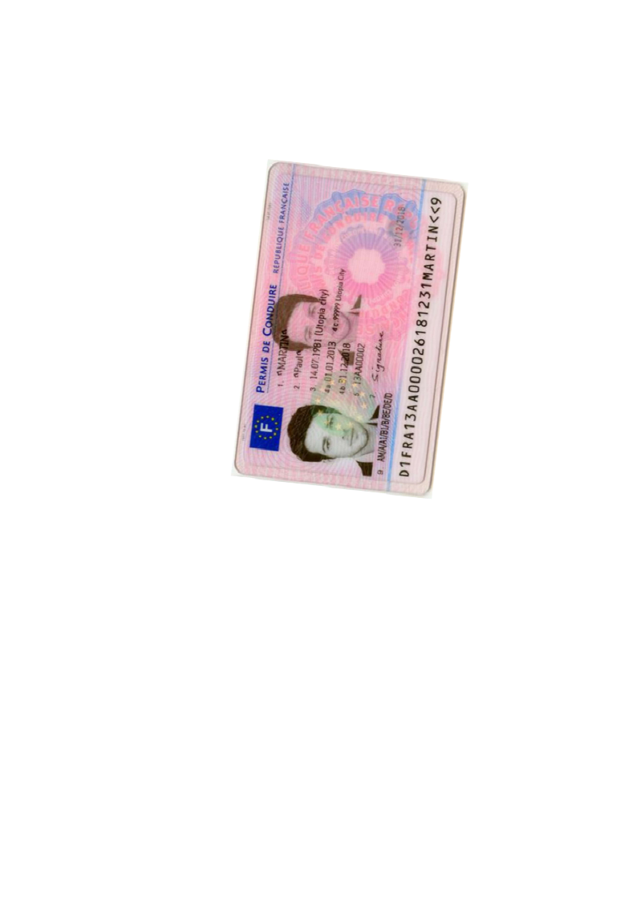
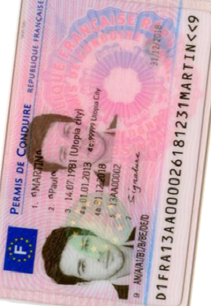
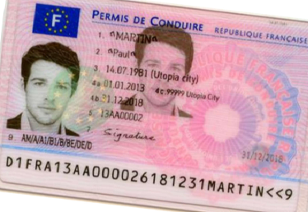
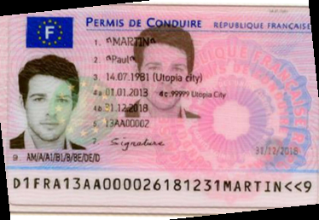
Zoning
OCR
Rotation
Page
Zoning
Orientation
Rotation
Zoning
OCR
Split
Split
Zoning
Orientation
Rotation
Zoning
OCR
Notes:
Guillaume
10 mins

Slide 7
Page
Zoning
Homography
Zoning
Zoning
OCR
OCR
Split
Split
Zoning
Homography
Zoning
OCR
Legend :
ML + code
Only code
Notes:
Guillaume
10 mins

Slide 8
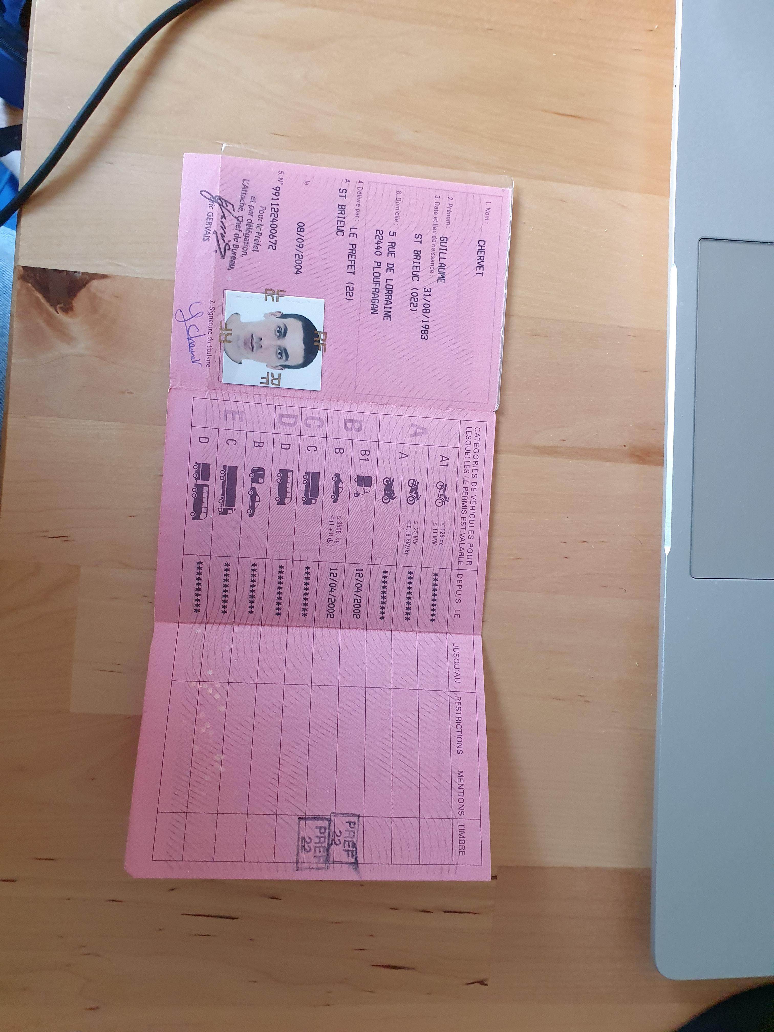
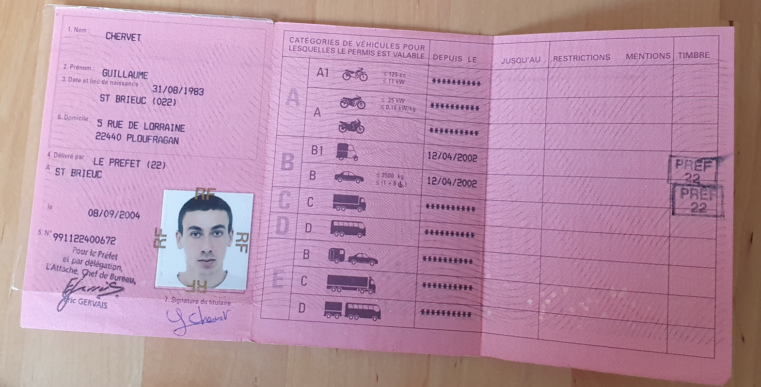

OCR
Split
Zoning
Orientation
Zoning
Classifier
Rotation
Zoning
OCR
Notes:
Guillaume
10 mins

Slide 9
OCR
Split
Zoning
Homography
Zoning
Classifier
Rotation
Zoning
OCR
Notes:
Guillaume
10 mins

Slide 10
Rapid development and iteration
Very Resilient to Change
Fast execution
Small cost in RAM/CPU
Reusable on many use cases

